Slide 1
Assigned By:
Sunanda Das
Assistant Professor,
Computer Science and Engineering
Khulna University of Engineering and Technology
Submitted By:
Israt Tasnim Esha
Roll: 1907090
Section: B
Department of Computer Science and Engineering

Slide 2
Objective
To delivery and receive food orders in a convenient way.

Slide 3
Introduction
It’s a Restaurant Food Management and Delivery app.
If any restaurant provides delivery facility, it can signup with its information and upload food photo and food information dividing them to many categories.
After signing in the app, consumers can see the available restaurants, their information and can give them rating also.
Continue…

Slide 4
Continued Introduction…
Consumers can select a restaurant and see the available foods and distance.
They can select their desired food, give instruction for making food, and add multiple items to their shopping cart.
They can also give a time limit to the seller to deliver the food.
They can payment with bKash or cash on delivery, then confirm the food order.
Continue…

Slide 5
Continued Introduction…
Then they have to wait for seller to accept or decline the order. They can also cancel the orders before/after seller accepting the order.
Seller can accept or decline the food orders given by consumers.
There is no middleman available in this system. Consumers and sellers can directly contact with each other.

Slide 6
Flow Chart
Start
Buyer / Seller ?
Buyer
Seller
Sign In/ Sign Up As Buyer
Sign In/ Sign Up As Seller
Continue as Buyer…
Continue as Seller…

Slide 7
Continue as Seller…
Add Food Items
Food Items/Notifications
Update Profile
Change Password
Delete Account/ Log Out
Change
Password
Add
Food Items
Delete
Account
Food
Items
Add
Food Items
Remove the Information
Update/Delete Food Information
Change
Password
Log
Out
Update Profile
Buyer / Seller ?
Notifications
Update Profile
Notifications

Slide 8
Continue as Buyer…
Shopping Cart
Ordered Food
Update Profile
Delete Account
Restaurants/ Log Out
Shopping Cart
Delete Account
Ordered
Food
Restaurants
Confirm Food Orders
Remove the Information
Add Food Items To Cart
Can Cancel Orders
Log
Out
Update Profile
Update Profile
Buyer / Seller ?

Slide 9
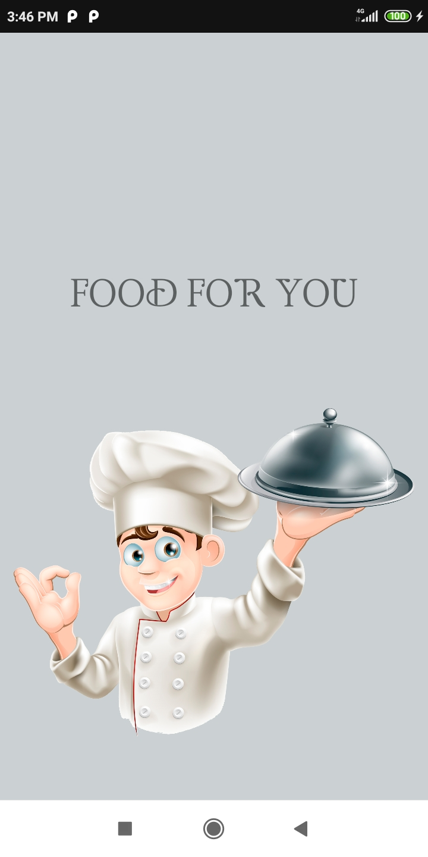
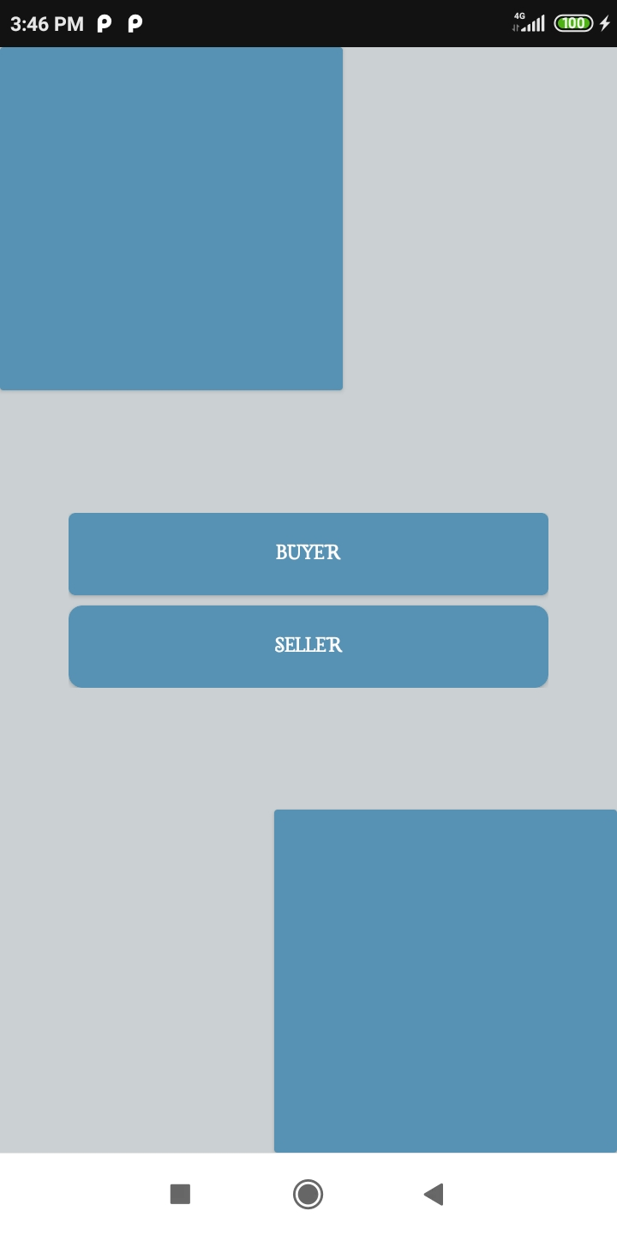
UI Description
And Workflow
Both of the Food Sellers and Consumers can use this app for their own purposes.
Continue...

Slide 10
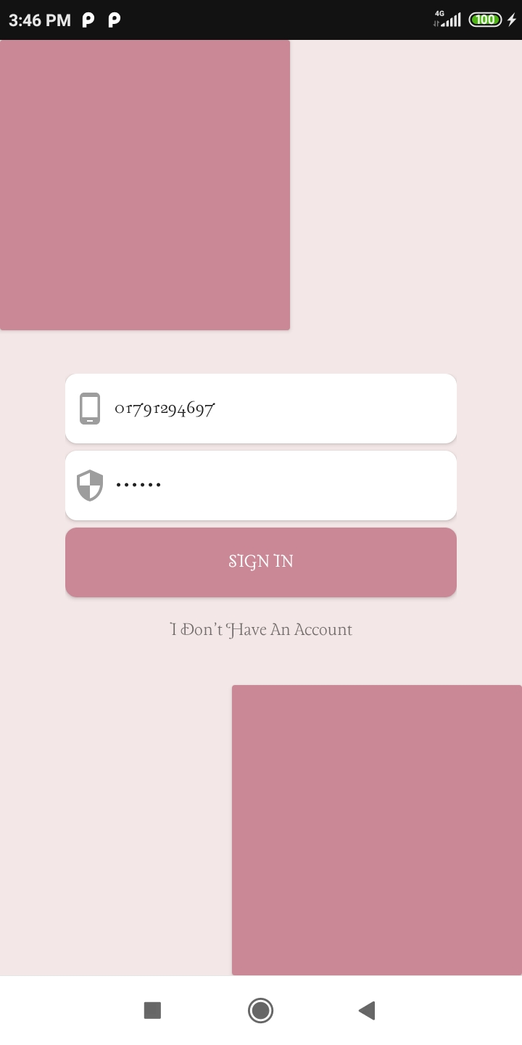
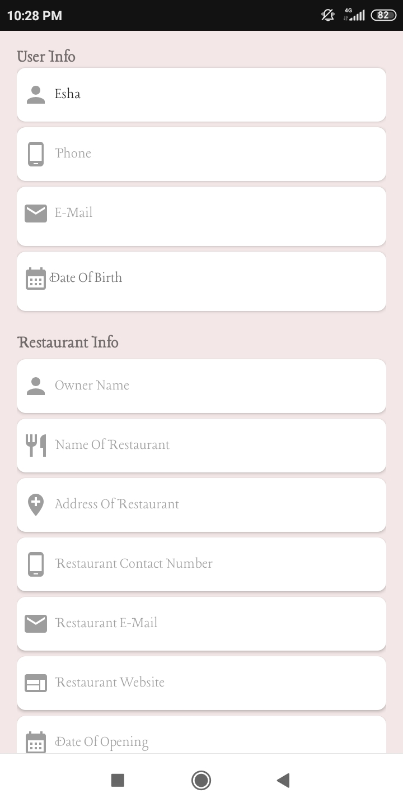
Continued Workflow…
If you are a food seller, tap to the seller button and sign in.
If you don’t have an account simply signup with your phone number and other necessary information.
Note that you can signup only once using a phone number.
Continue...

Slide 11
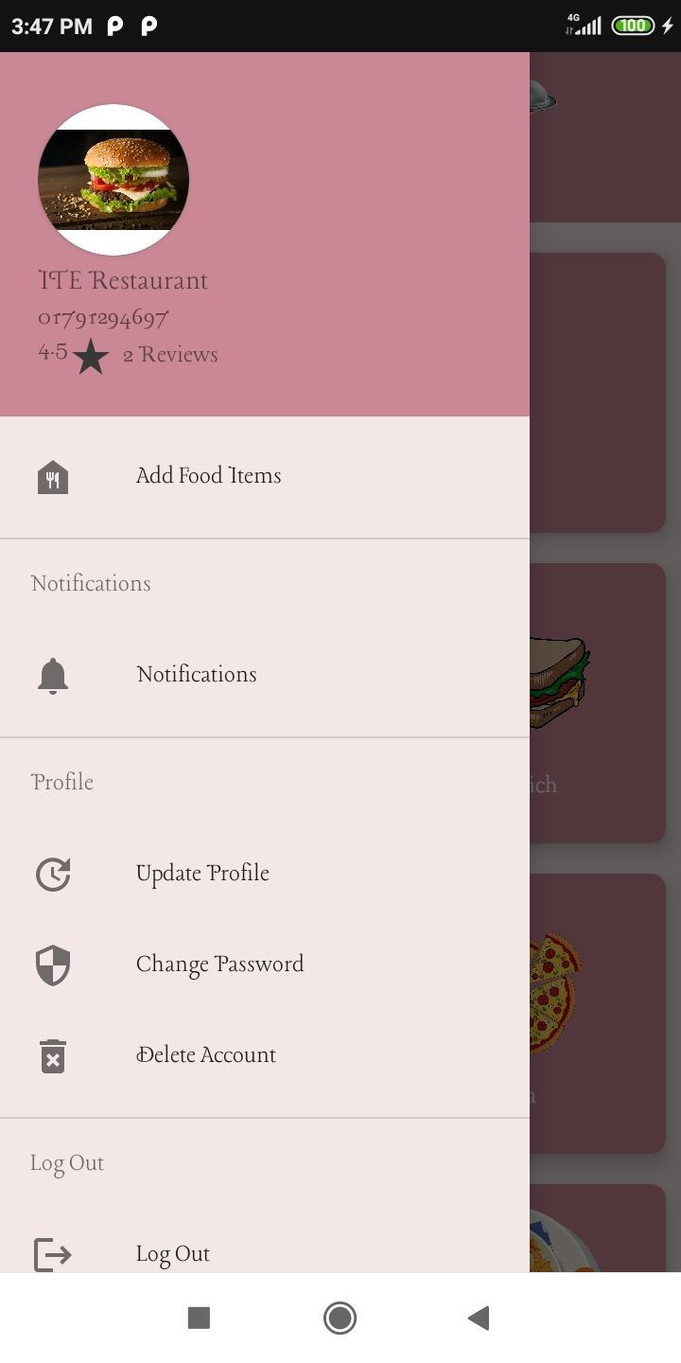
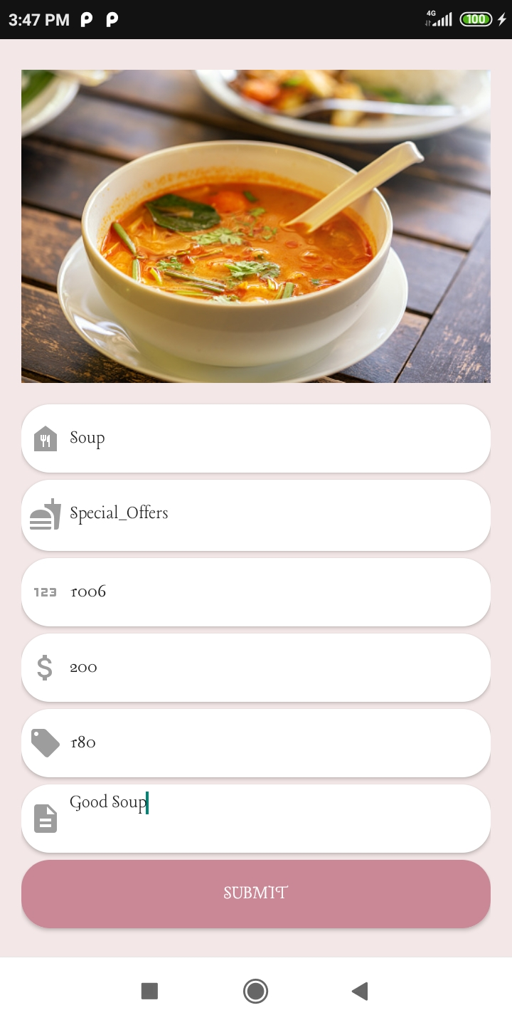
Continued Workflow…
To add food items for your restaurant, tap to ‘Add Food Items’ from Navigation Drawer, .
You should select a specified food type and give Food name, price and obviously a code for this food to specify this.
To add food items for your restaurant, tap to ‘Add Food Items’ from Navigation Drawer, .
You should select a specified food type and give Food name, price and obviously a code for this food to specify this.
Continue...

Slide 12
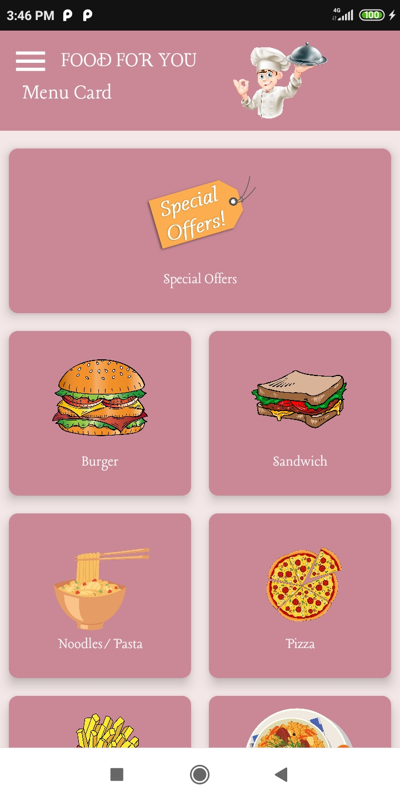
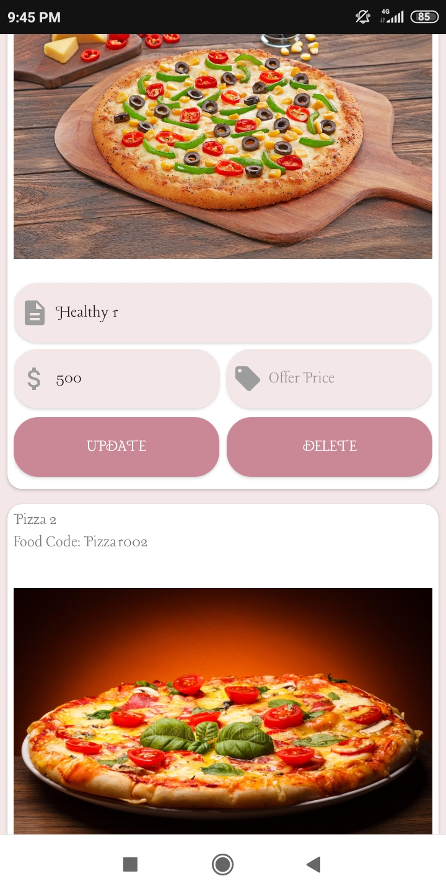
Continued Workflow…
From Home Page, you can overview different types of the food items of your restaurant.
You can update food information and also can delete a selected item.
Continue...

Slide 13
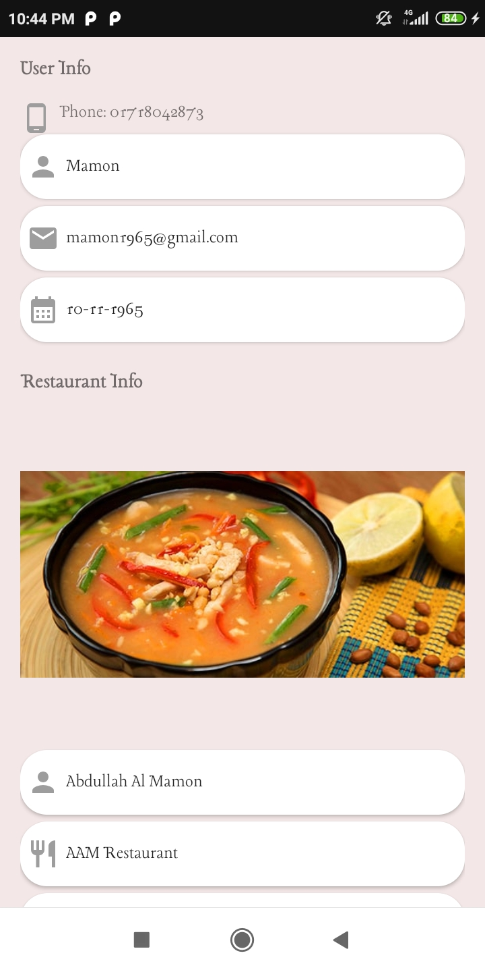
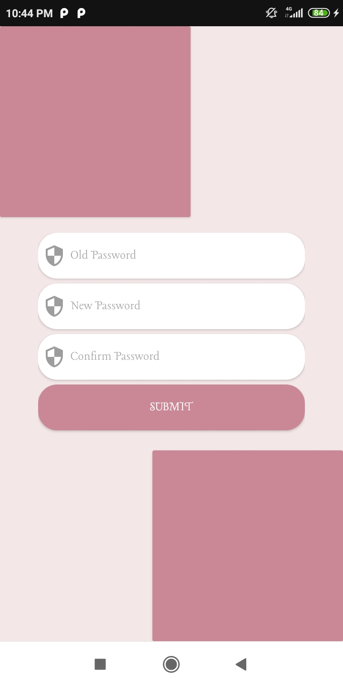
Continued Workflow…
You can update information, upload restaurant photo and change password tapping the options from navigation drawer.
You can also delete your account if you have no pending order. To delete, just cancel the orders and clean the ‘Notifications’ page.
Continue...

Slide 14
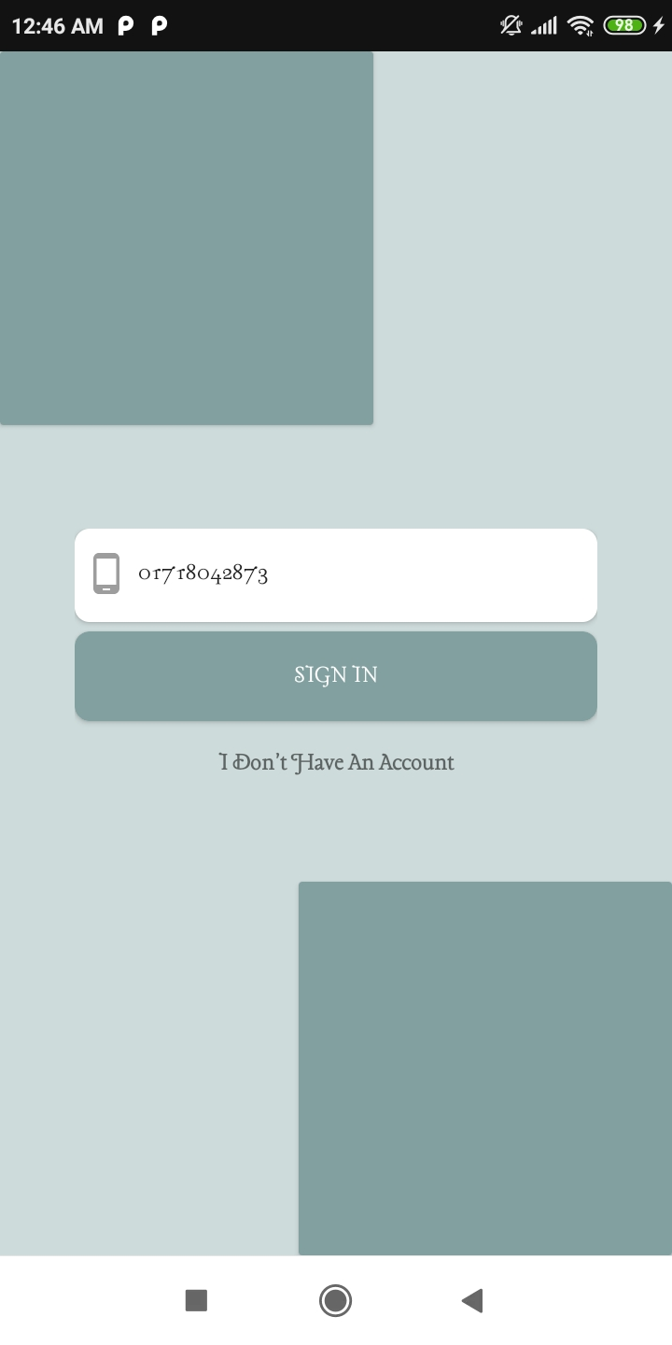
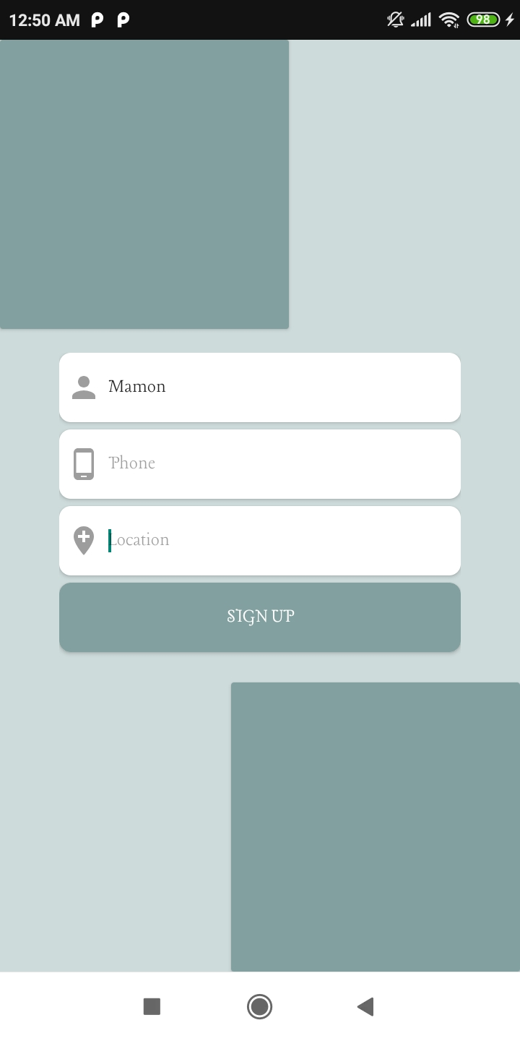
Continued Workflow…
If you are a food consumer, tap to the buyer button an sign in.
If you don’t have an account simply signup with your phone number and other necessary information. Note that you can signup only once using a phone number.
Continue...

Slide 15
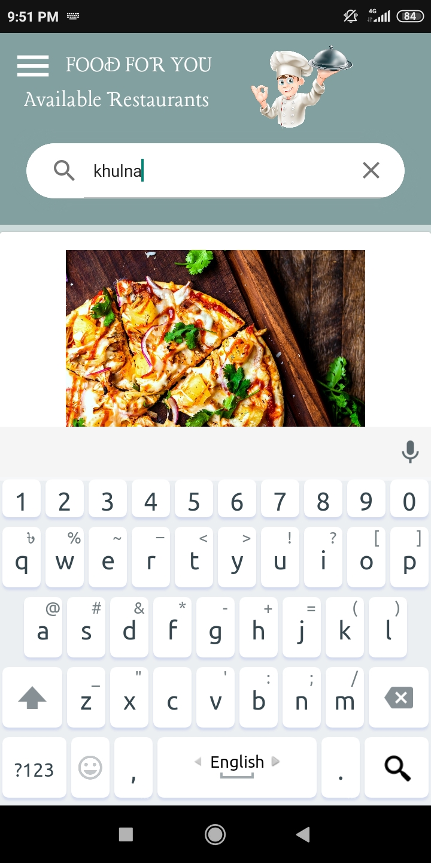
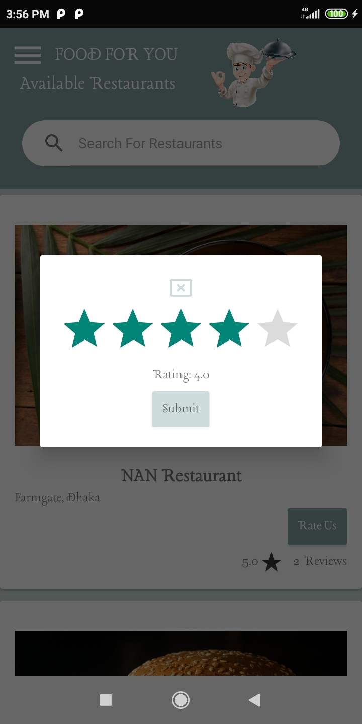
Continued Workflow…
This is the Home Page. It will show you available restaurants and ratings of them.
You can search any restaurant with restaurant name or location and also can give ratings to the restaurants.
Tap to the restaurant card to overview the information.
Continue...

Slide 16
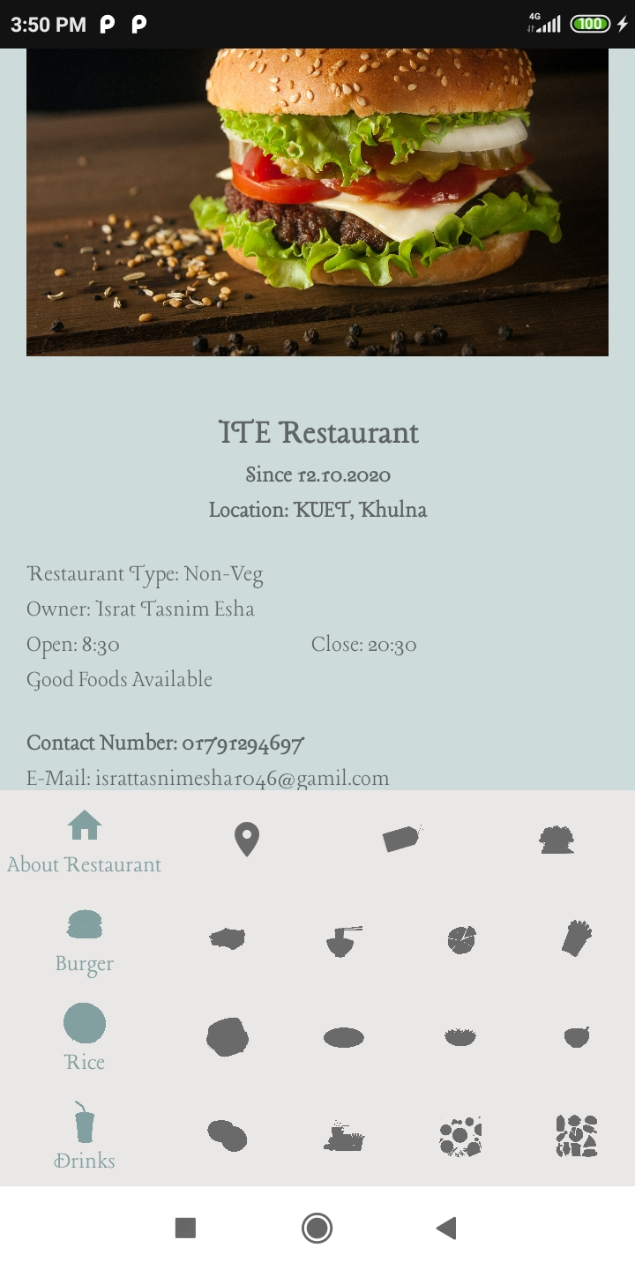
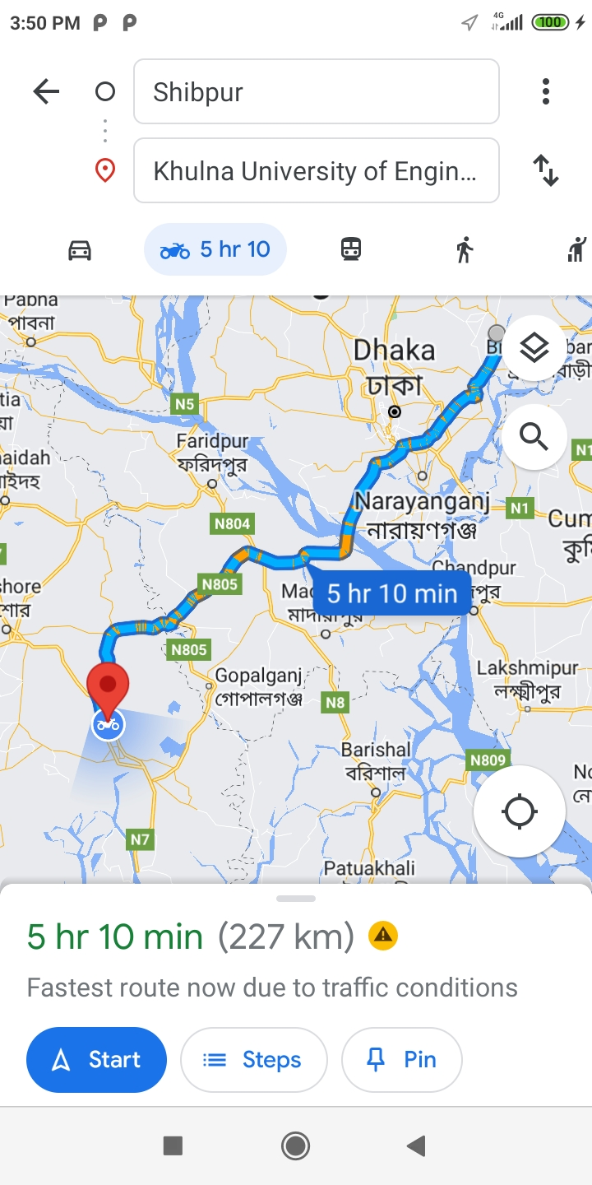
Continued Workflow…
Tap to ‘About restaurant icon’ for the restaurant information.
Tap to ‘location icon’ to see the distance between you and restaurant from google map.
Tap food icons to see different types of available foods of this restaurant.
Continue...

Slide 17
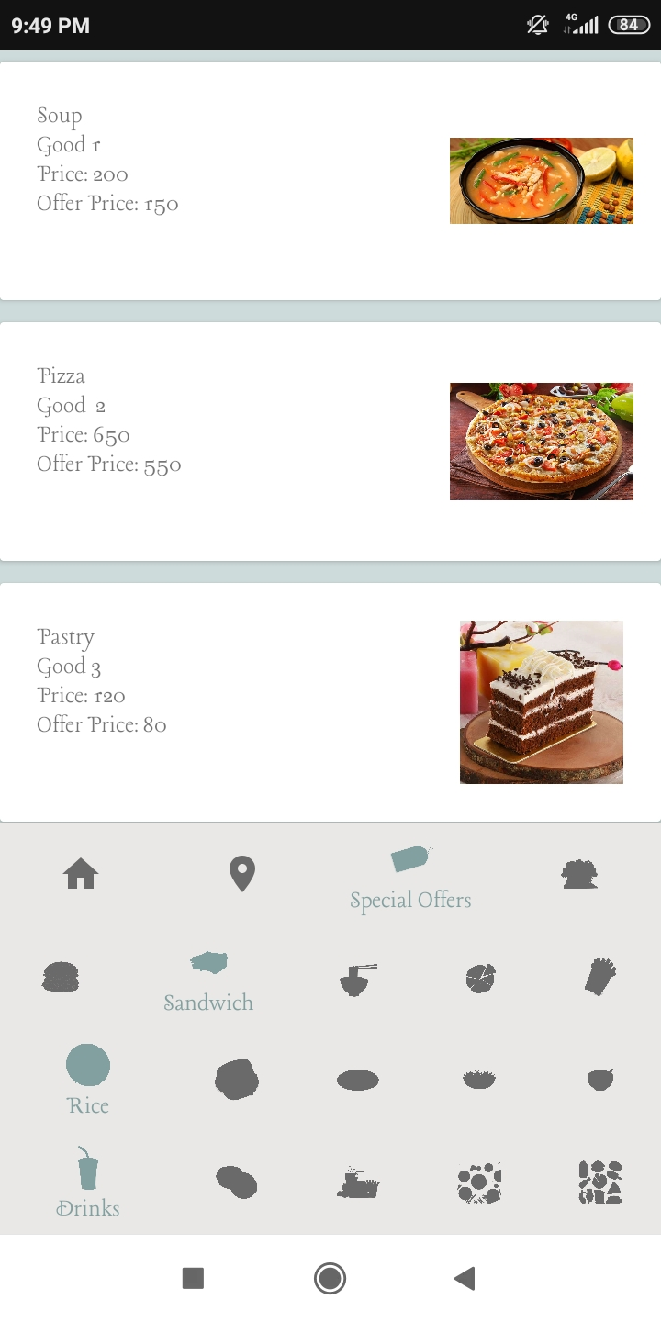
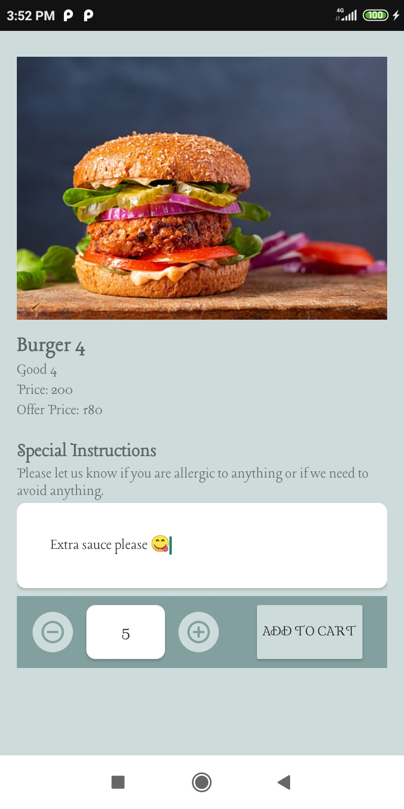
Continued Workflow…
Tap to your desired food.
You can increase or decrease item number or can manually write the number and can give instructions too.
Tap ‘Add to Cart’ button. Now this item has been added to your cart.
Continue...

Slide 18
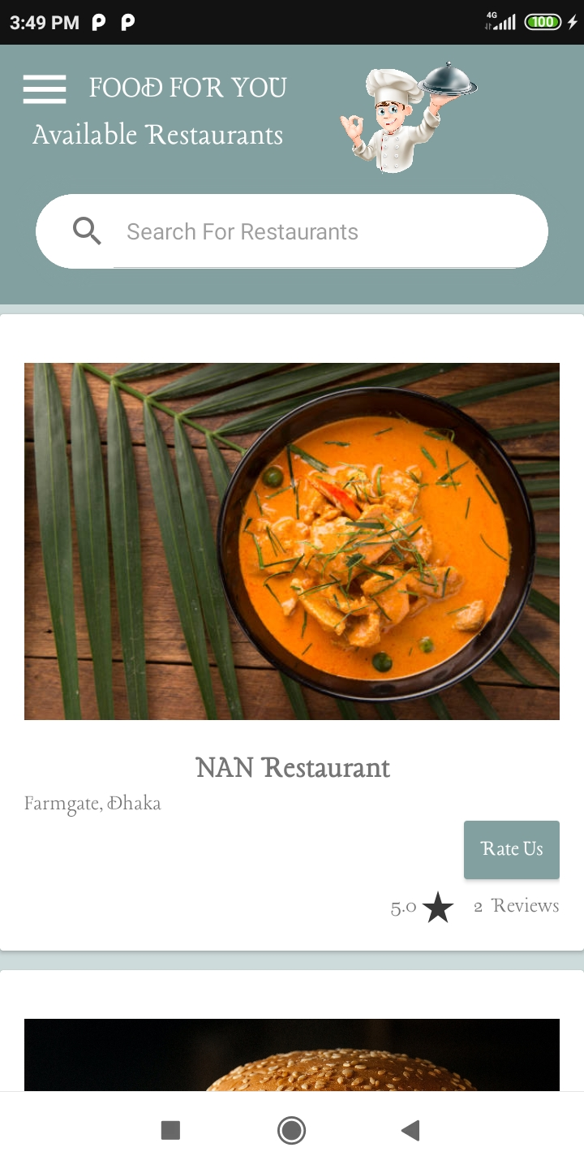
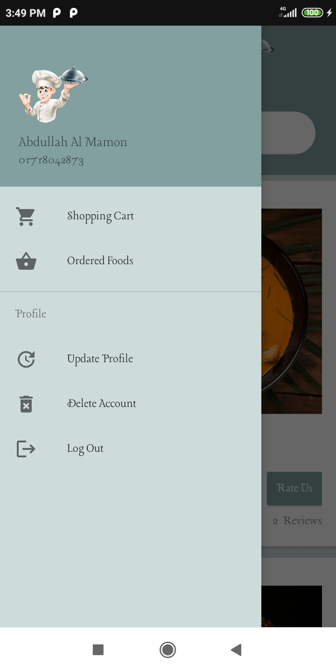
Continued Workflow…
You can log out or update information by tapping to ‘Update Profile’ from navigation drawer.
You can also delete your account if you have no pending order.
Tap to the ‘Shopping Cart’ button to see your cart.
Continue...

Slide 19
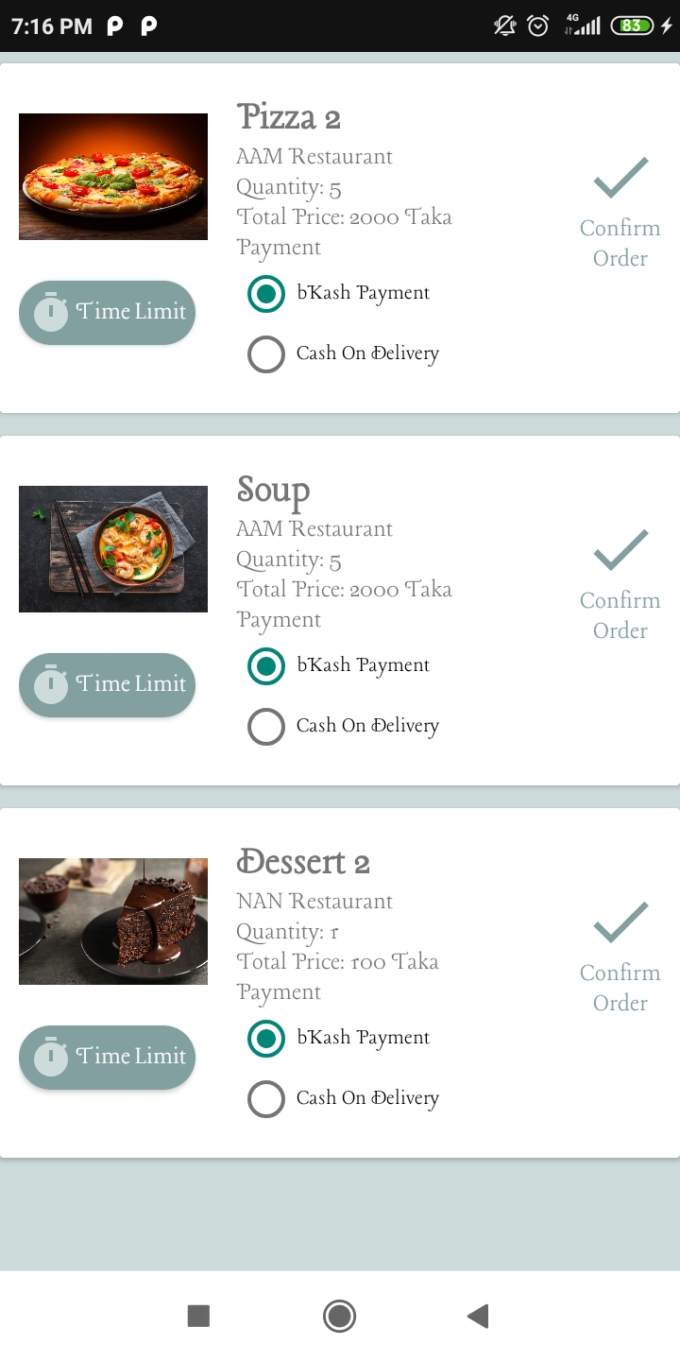
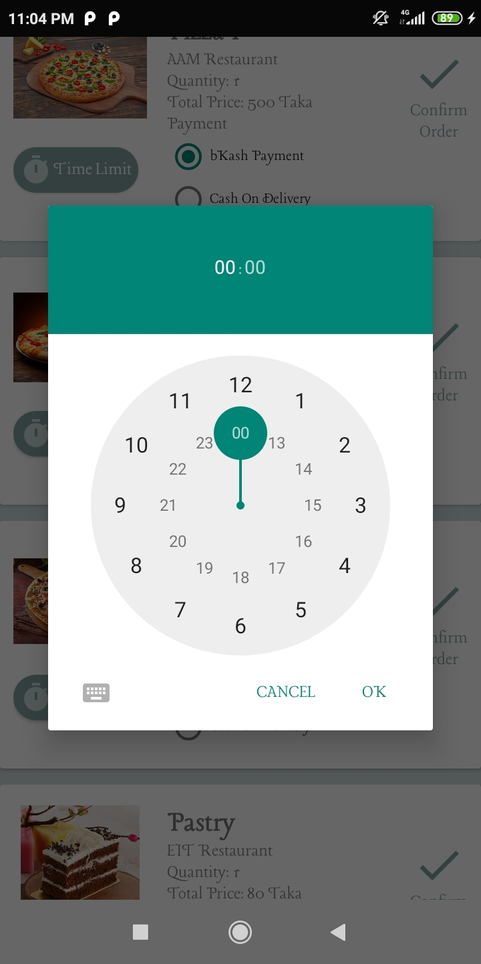
Continued Workflow…
You can delete the item from cart by long tapping the selected food card.
You can also give a time limit to the seller to deliver the food.
Continue...

Slide 20
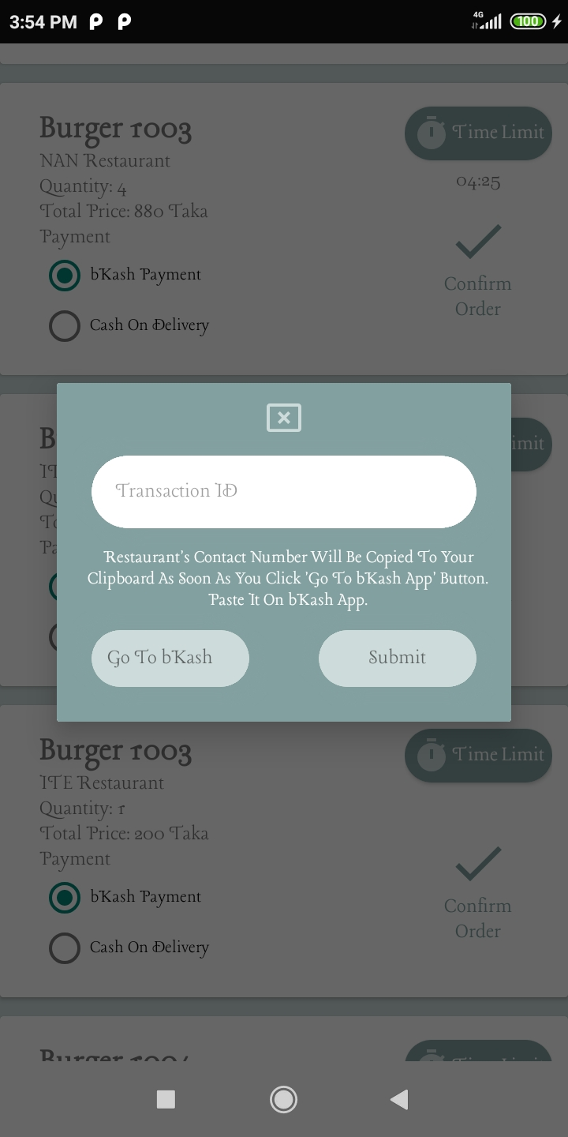
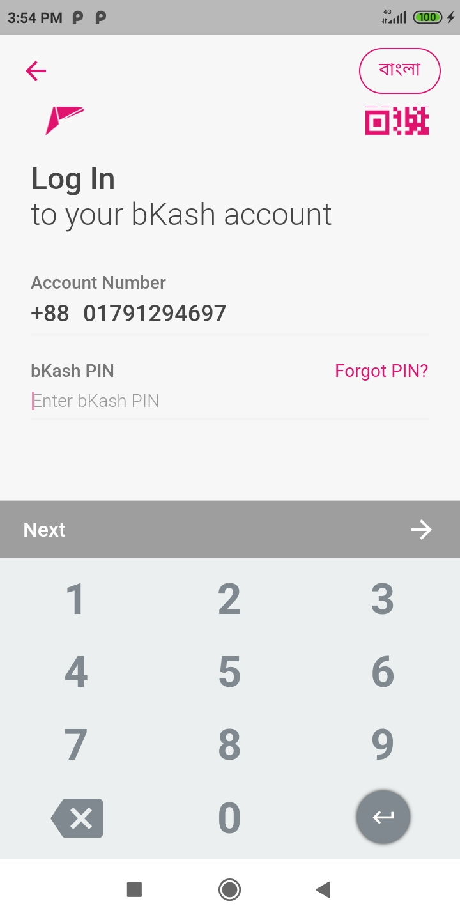
Continued Workflow…
If you select bKash Payment, you have to give the transaction id of your payment. Food will be ordered after tapping ‘Submit’ button.
Tap to the ‘Go to bKash’ button to pay using your bKash account.
You can also select ‘Cash On Delivery’ as payment system.
Continue...

Slide 21
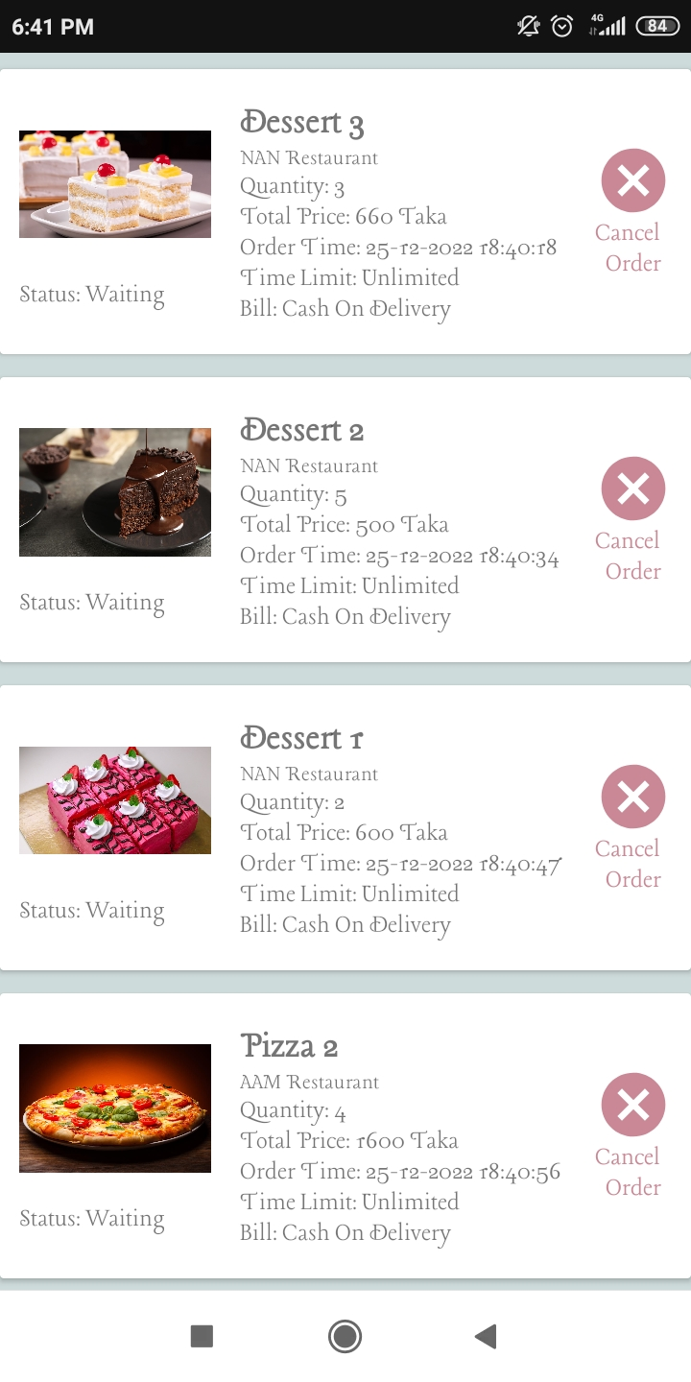
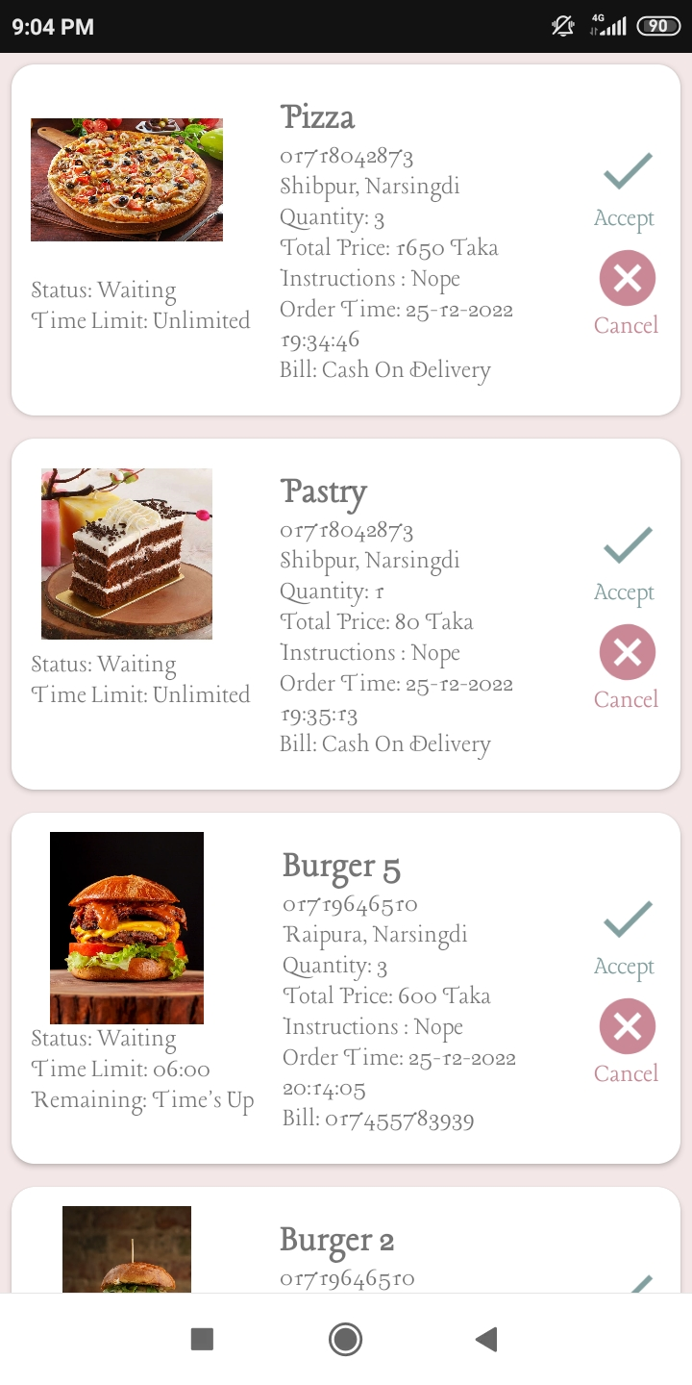
Continued Workflow…
You can see your ordered food by tapping ‘Food Orders’ from navigation drawer.
You have to wait for seller to accept or decline the order. You can also cancel the orders.
At seller account, you can accept or decline the food orders given by consumers.

Slide 22
Methodology
To make this app, I’ve used java language and xml to implement UI designs.
Seller can decline to take a order from consumer and then consumer accept/ cancel the order by mistake.
Similarly, consumer can cancel a order and then seller can accept/ decline the order by mistake.
Continue…

Slide 23
Continued Methodology…
Or, Seller/Consumer can delete their account while they have pending food orders.
In these situations, app can crash. I’ve fixed these problems.
Besides, If consumer select bKash Payment, but he has no bKash app on his phone, here app can crash too.
I’ve used try catch so that, in this situation, app will send him to the google playstore to install bKash app.

Slide 24
Applications
No middleman is available. Sellers and consumers can directly contact with each other, so no extra charge is required for middleman.
Consumers can give instructions for making food and can also give a time limitation.
Both sellers and consumers can decline/cancel the orders at any time.

Slide 25
THANKS ALL

